Slide 1
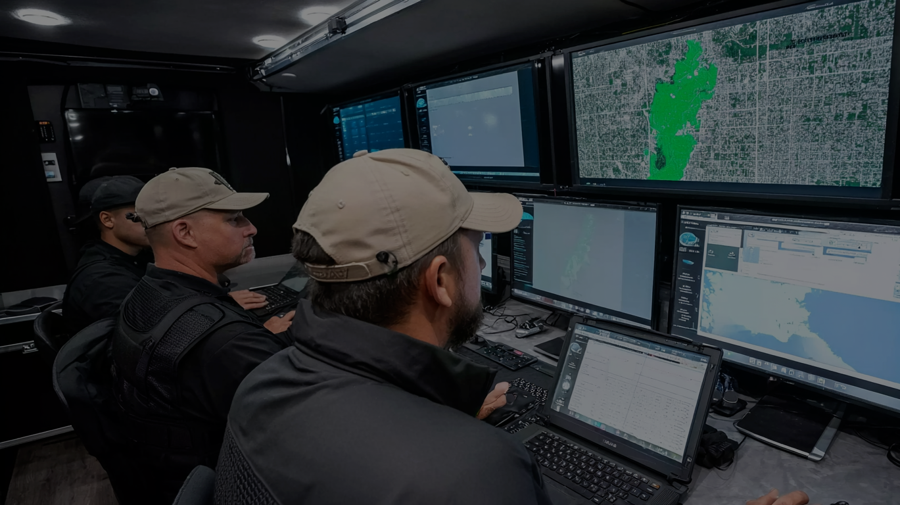





The Future Of
Autonomous Security
Unmanned AI Control Rooms for Defense, Security & Smart Cities
Dec 2025
Notes:
Slide 0:
Cover Slide
The Future of Autonomous Security
Unmanned AI Control Rooms for Defense, Security & Smart Cities
[Logo]
Investor Deck | [Date]

Slide 2

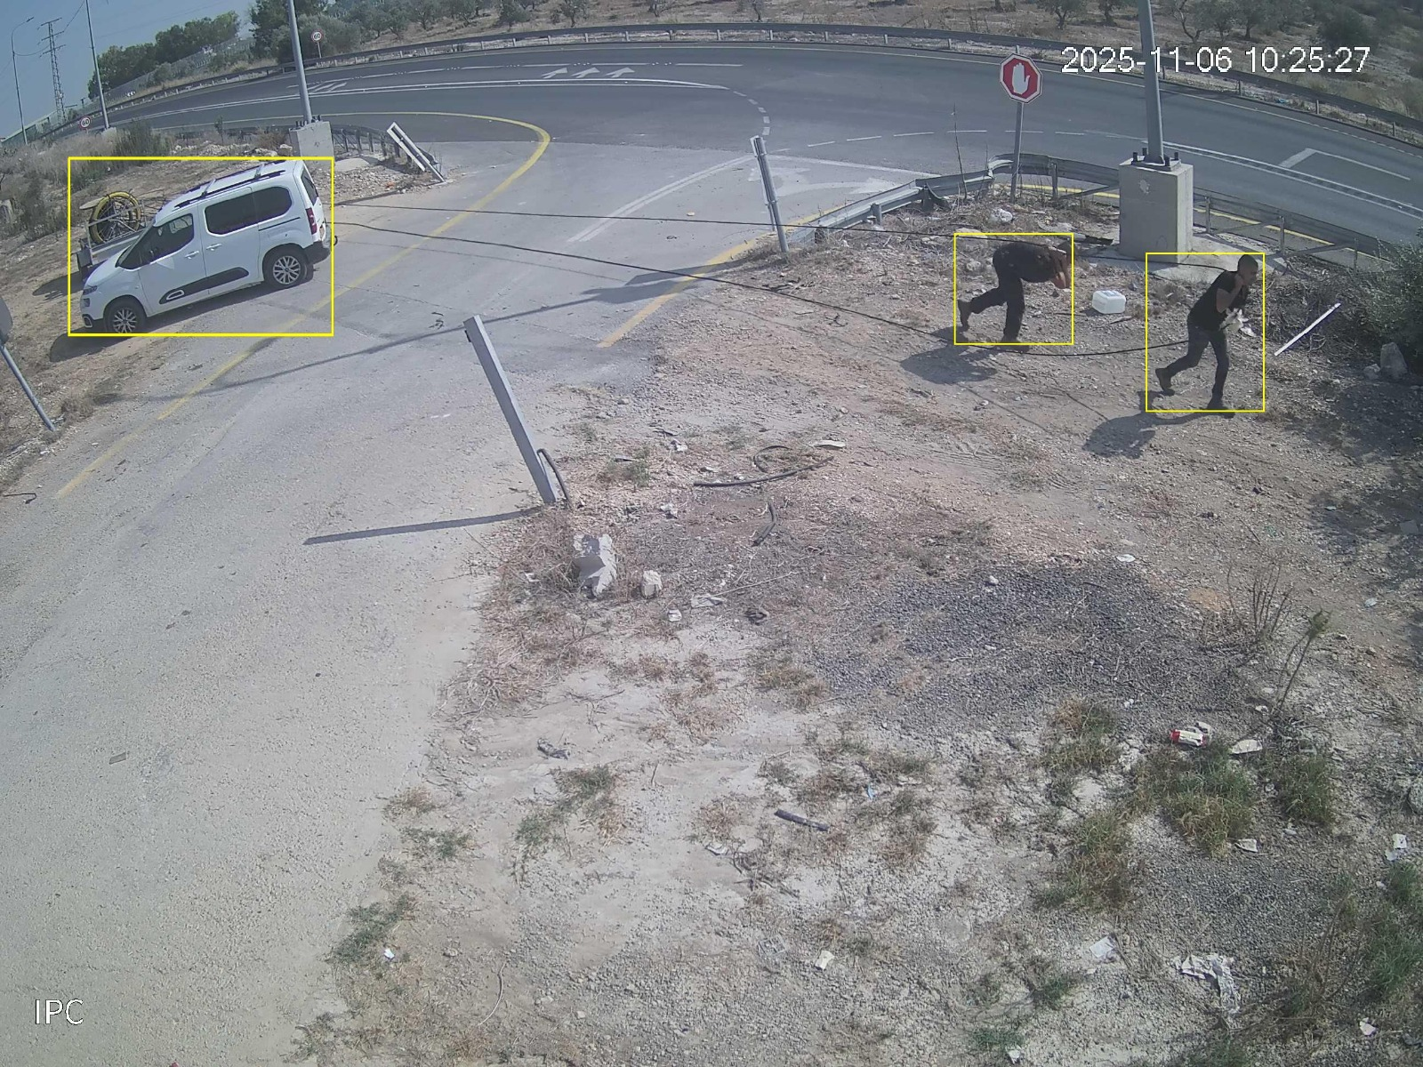




Zorronet: Autonomous Security, Delivered
AI-powered platform for real-time detection, response, and multi-device orchestration
Connected communities share alerts during incidents instantaneously
Works with almost any camera, sensor, drone, or system
Zero hardware replacement. Zero operator load. One unified system.
2
Notes:
Slide 1: Zorronet: Autonomous Security, Delivered
AI-powered platform for real-time detection, response, and multi-device orchestration
Works with any camera, sensor, drone, or system
Built for municipalities, defense, and enterprise security teams
Zero hardware replacement. Zero operator load. One unified system.

Slide 3
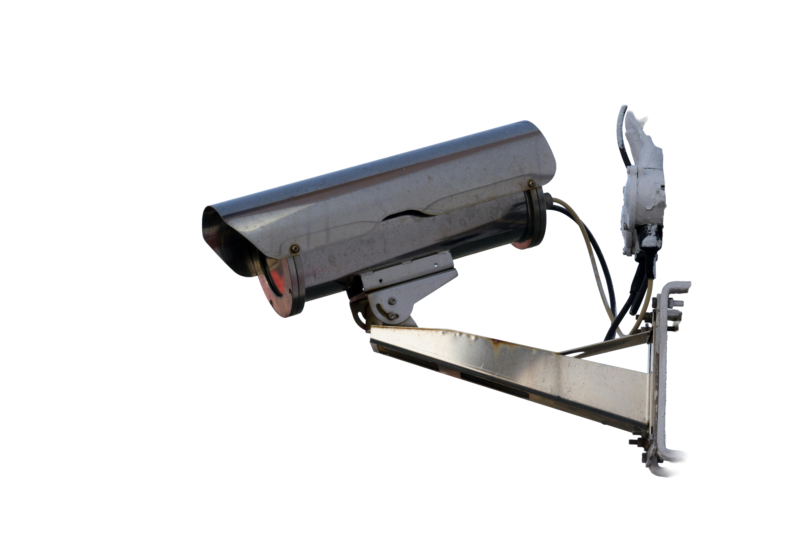

Security is Hitting a Breaking Point
01
02
Operators are buried under thousands of alerts, with many being false or irrelevant.
Cameras don’t coordinate, systems don’t talk to each other, and response is slow and fragmented.
03
04
This leads to missed events and real losses.
Traditional security can’t scale with modern threats, but AI security can.
3
Notes:
Slide 2: The Challenge Today
Security teams manage siloed cameras, sensors, and legacy SOC systems
Manual monitoring leads to missed events, delayed response, and high false alarm rates
Upgrading infrastructure is expensive, slow, and complex
Organizations lack a unified, autonomous command layer

Slide 4




Introducing Zorronet: The Autonomous Security OS
A full-stack AI Security OS that connects all devices into one intelligent network
Deploys instantly on existing infrastructure
Autonomous monitoring using data-stream analysis, not heavy video processing
Automatically detects events, filters noise, and triggers coordinated responses
4
Notes:
Slide 3 The Zorronet Solution
A full-stack AI Security OS that connects all devices into one intelligent network
Autonomous monitoring using data-stream analysis, not heavy video processing
Automatically detects events, filters noise, and triggers coordinated responses
Deploys instantly on existing infrastructure

Slide 5


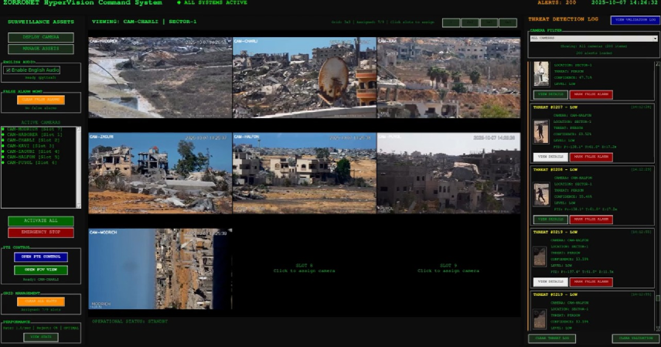
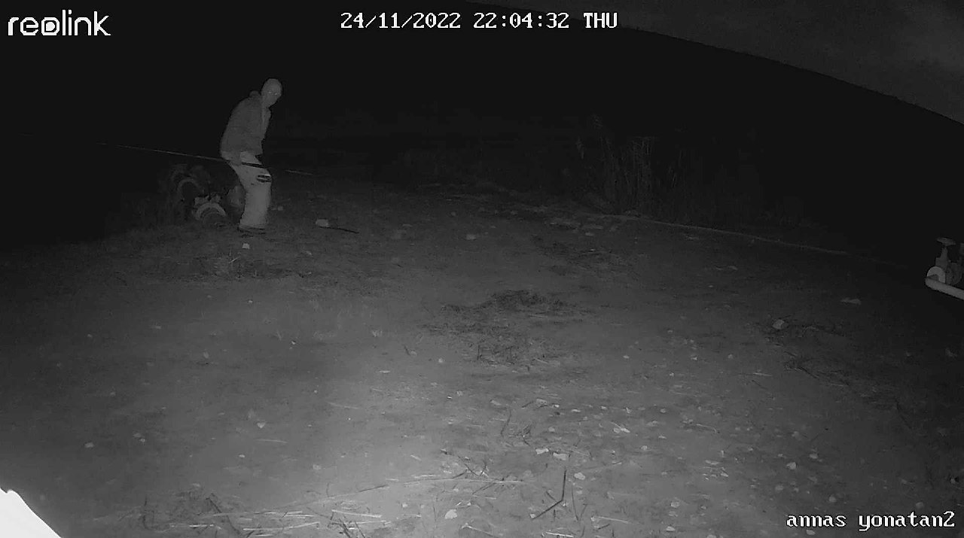
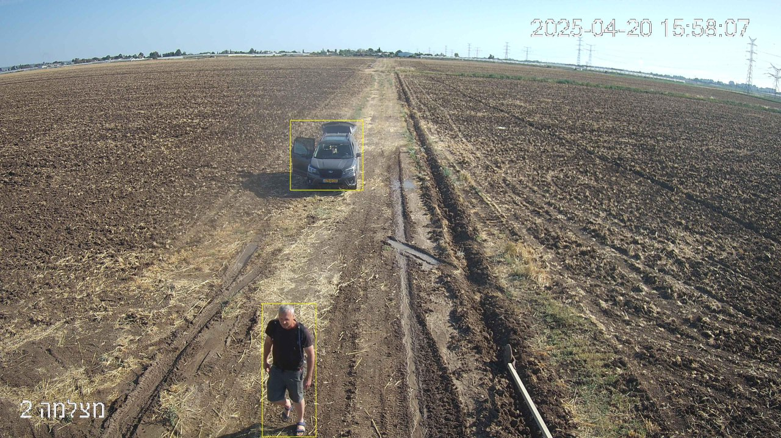
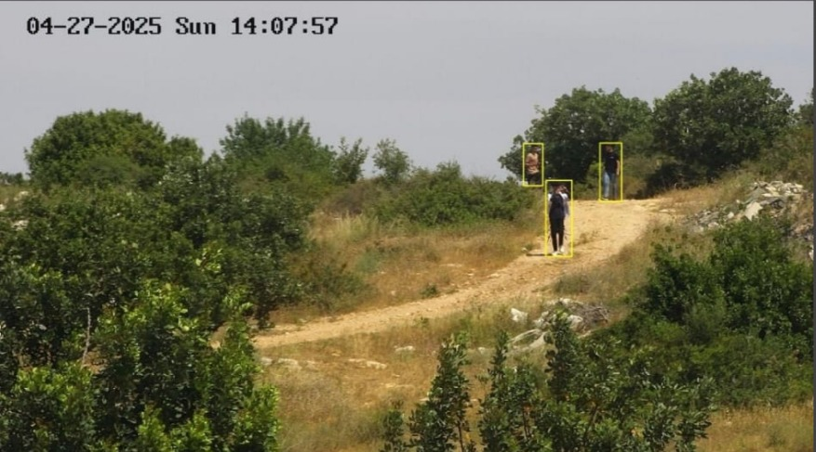

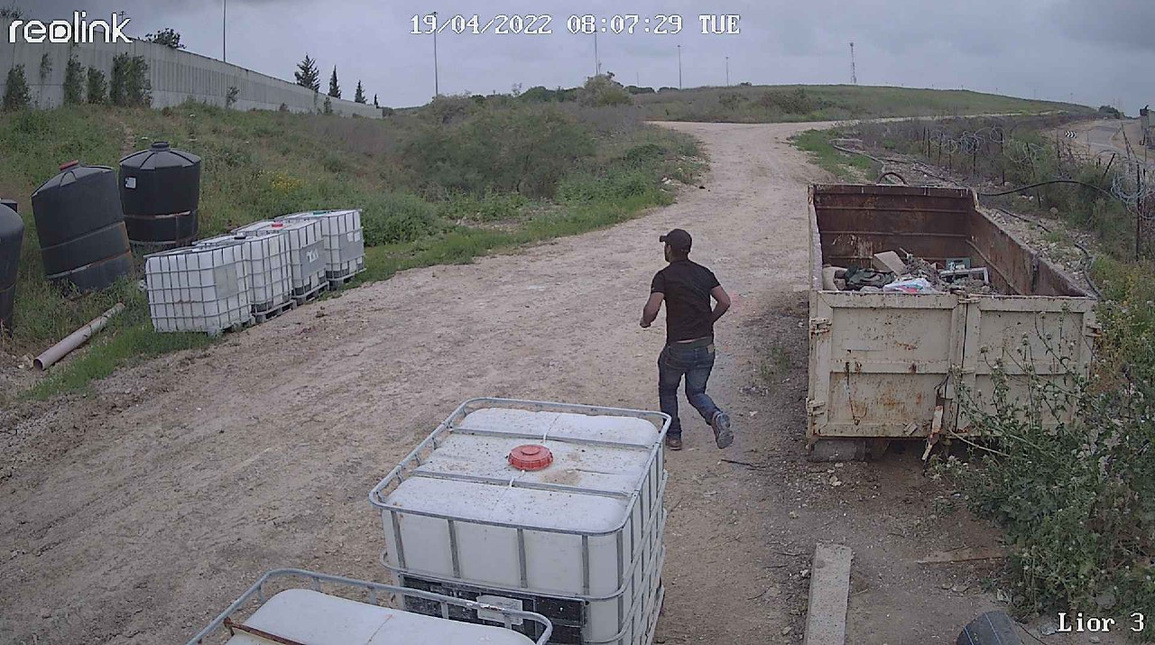
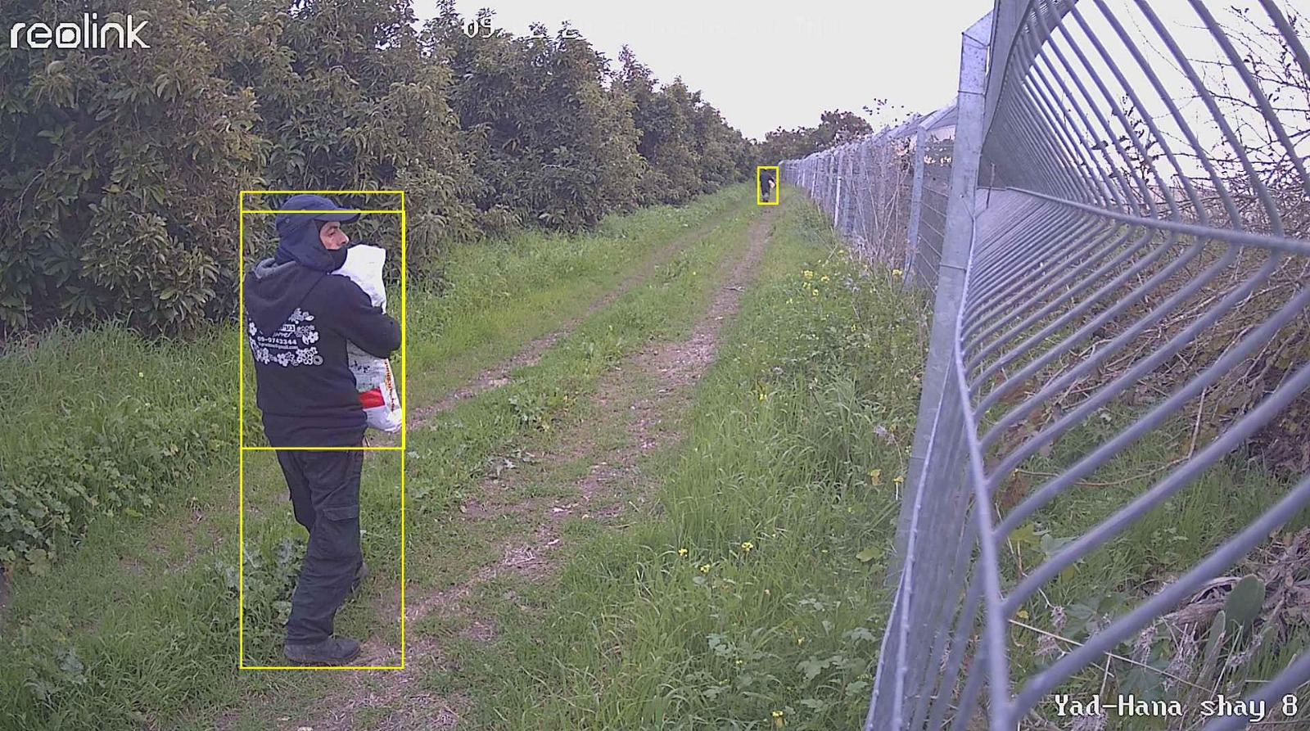
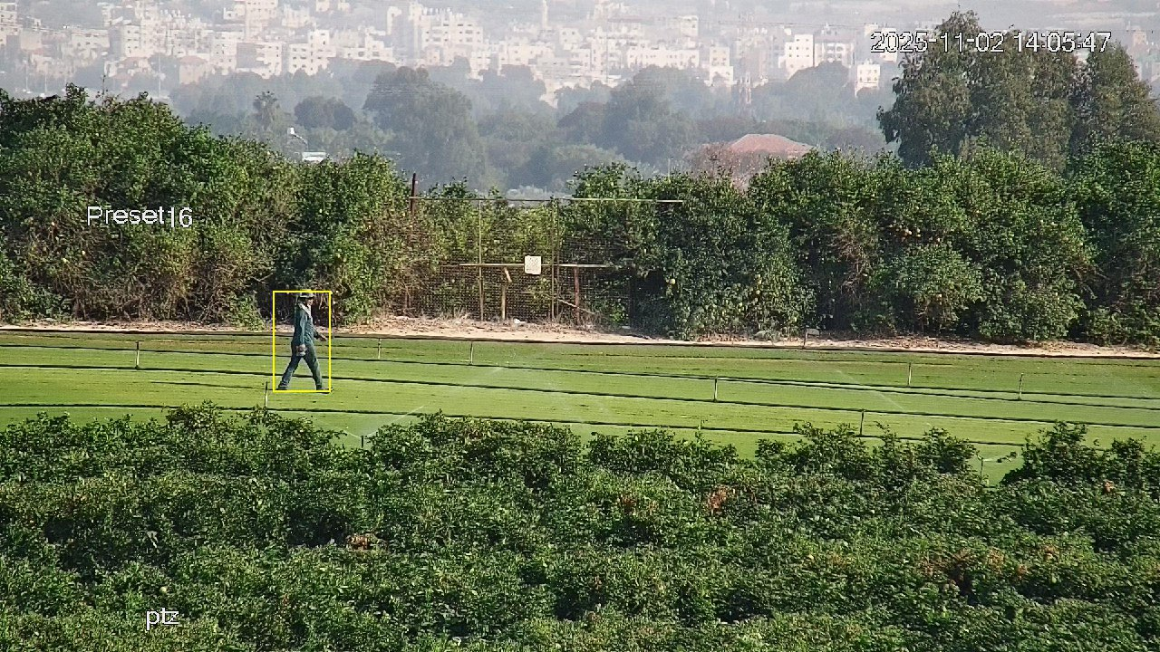

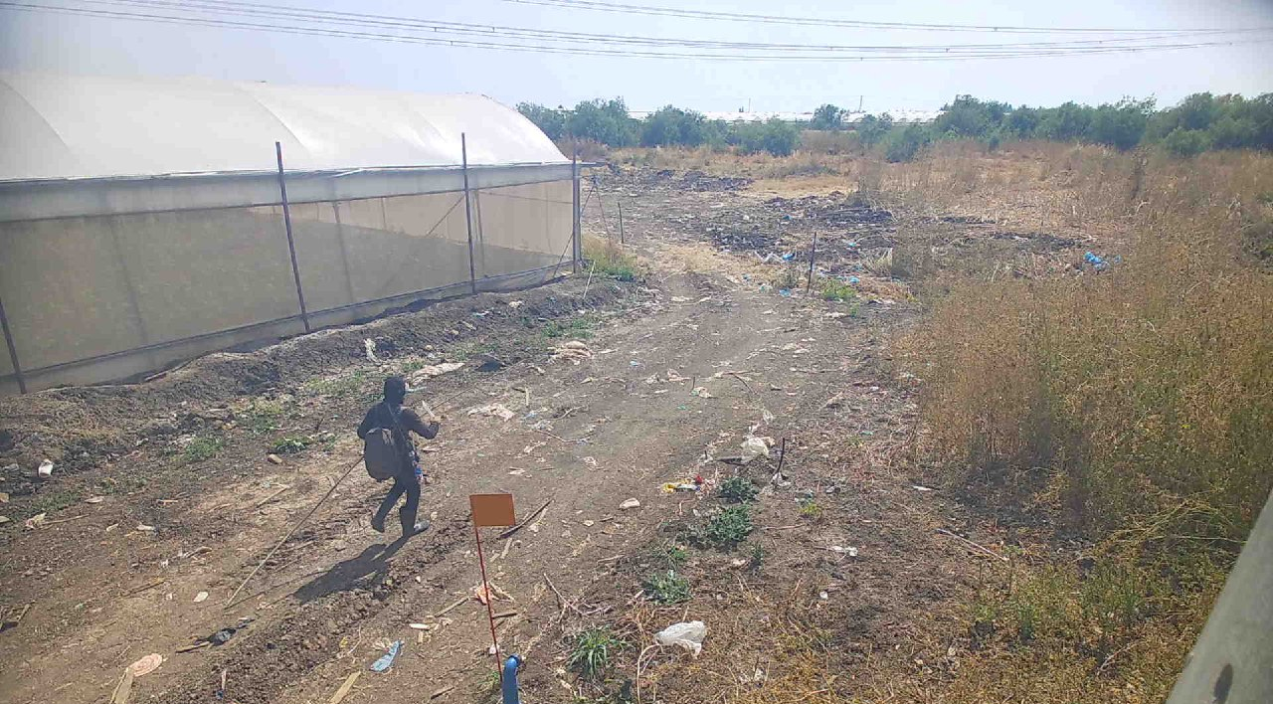
Why Automation Matters
PTZ movement, alerts, gates, drones, and emergency workflows
Zorronet’s computer vision looks at camera/sensor data streams to detect anomalies in real time
It then cross-analyzes metadata with AI and operational logic
It then distributes relevant event data to the right people, instantly
5
Notes:
Slide 4: How It Works
Zorronet’s computer vision looks at camera/sensor data streams to detect anomalies in real time
It then cross-analyzes metadata with AI and operational logic
PTZ movement, alerts, gates, drones, and emergency workflows
It then distributes relevant event data to the right people, instantly

Slide 6

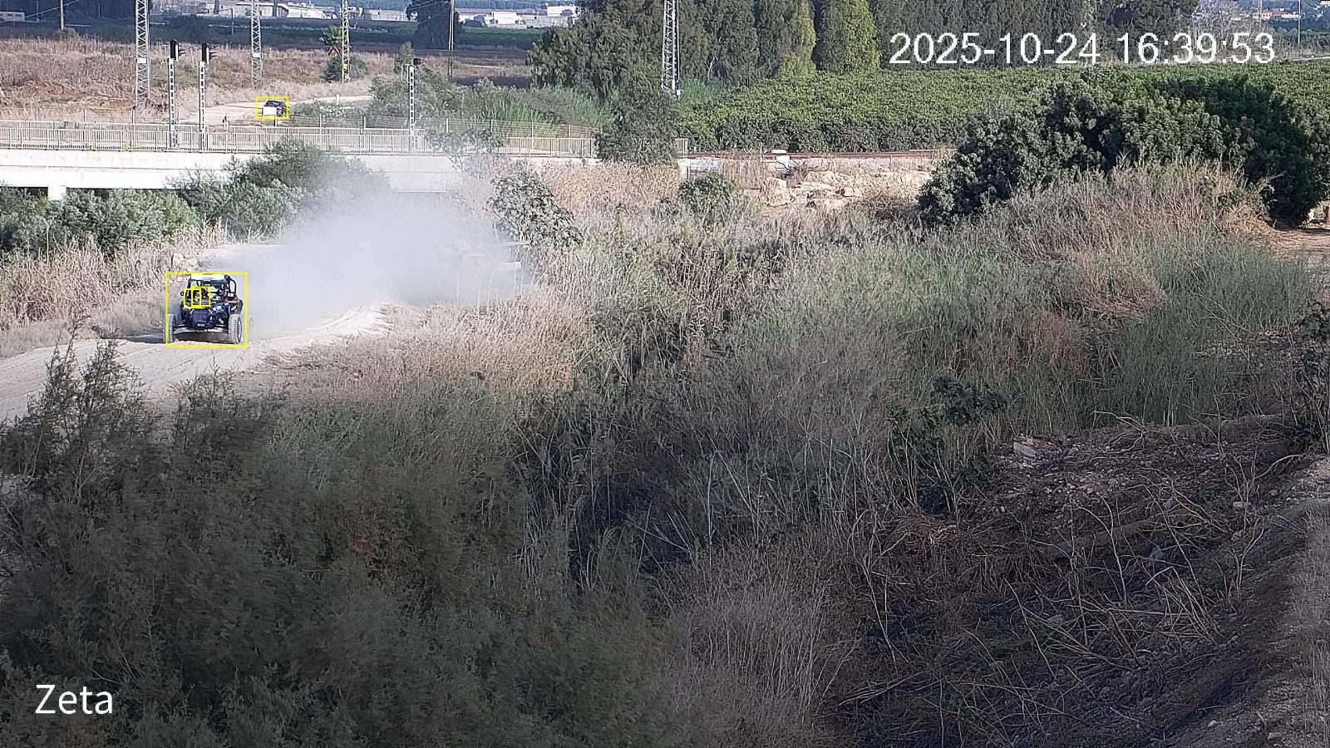
Zorronet Product Suite
A modern, modular OS built for the real world:
AI Security OS:
Zorronet Mobile App:
Understands movement, detects threats, filters noise, and predicts risk.
Real-time alerts, live video calls, field ops, and more.
Zorro Gates:
Integrations Layer:
Autonomous access control: gate activation, sensor fusion, and event-driven responses.
Connects to almost any camera, drone, sensor, LPR, IoT device, or alarm system.
Everything works together.
One OS. One mission. Zero blind spots.
6
Notes:
Slide 5: Zorronet Product Suite
HyperVision Command: AI SOC interface for detection, mapping, and PTZ automation
AI Security OS: The core AI engine powering anomaly detection & orchestration
Zorronet Mobile App: Alerts, communities, panic, and field response
Zorro Gates: Remote command, access control, mapping & permissions
Integrations Layer: Drones, cameras, radars, LPR, sensors, IoT

Slide 7




Autonomous Intelligence Engine
Uses AI to spot unusual movement, behavior, or objects the moment they appear
Filters out noise so operators only see alerts that matter
Learns each site’s patterns to improve accuracy over time
Reduces workload by turning routine monitoring into a fully autonomous operation
7
Notes:
Slide 7: Autonomous Intelligence Engine
Uses AI to spot unusual movement, behavior, or objects the moment they appear
Filters out noise so operators only see alerts that matter
Learns each site’s patterns to improve accuracy over time
Reduces workload by turning routine monitoring into fully autonomous operation
Pic of person in field with a gun

Slide 8

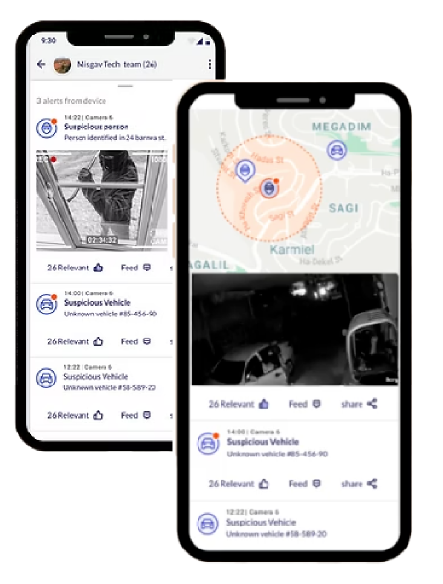





Zorronet Mobile App: Security in Your Hand
Near-real-time alerts with video clips, images, location, and recommended actions
Built for field teams, managers, and first responders
Secure chats, emergency channels, and off-grid indicators
Connected sites can share incident notifications with neighbors or nearby facilities
Start a WatchMe video call with the control center or community before triggering SOS
8
Notes:
Slide 9: Zorronet Mobile App
Near-real-time alerts with video clips, images, location, and recommended actions
Start a WatchMe video call with the control center or community before triggering SOS
Connected sites can share incident notifications with neighbors or nearby facilities
Secure chats, emergency channels, and off-grid indicators
Built for field teams, managers, and first responders

Slide 9


Community-Based Security
Threats don’t stay in one place.
That’s why Zorronet created communities. Each site gets its own community so that alerts are only routed to relevant personnel.
It also enables neighboring sites and communities to support each other, creating a safety network that grows stronger with every connected user
Security is no longer siloed
9
Notes:
Slide 10: Community-Based Security
Each site has dedicated “communities” with permissions & access control
Alerts are shared only with relevant teams based on role and location
Nearby “communities” can collaborate, reporting unusual activity to each other
One location can temporarily use another site’s cameras or devices during an incident
The shared-security model scales from installations and military bases to municipalities and national borders

Slide 10

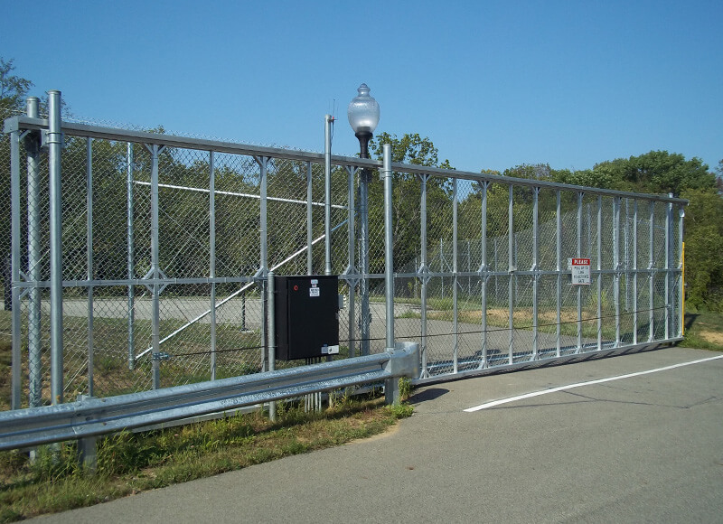
Zorro Gates Module
Access control that reacts in real time.
With AI-driven gate activation and real-time sensor fusion, Zorro Gates make your gates much more than just a simple barrier that opens and closes.
Using route tracking and automatic vehicle identification, your gate become intelligent, knowing exactly when to open and who to open for, automatically.
10
Notes:
Slide 11: Zorro Gates Module
Remote control of gates/doors from app or web dashboard
Real-time map showing all gate locations and statuses
User/Admin permission management
Works autonomously with pre-defined scenarios (e.g., auto-open for emergency vehicles)
Find zoro gates

Slide 11







Integrations Layer
Zorronet integrates seamlessly with:
Connects to cameras, sensors, drones, radars, LPR, fire systems, and more
All devices work together using one easy-to-use platform for a coordinated response
Nearby sites can join an event and add extra visibility when needed
Automates actions like scanning, lighting, alerts, and access control
Easy to expand - new devices can be added as a site grows
Creates one coordinated security system instead of siloed tools
Zorronet becomes the brain of your entire security network.
11
Notes:
Slide 12: Integrations Layer
Connects to cameras, sensors, drones, radars, LPR, fire systems, and more
All devices work together using one easy-to-use platform for a coordinated response
Nearby sites can join an event and add extra visibility when needed
Automates actions like scanning, lighting, alerts, and access control
Easy to expand - new devices can be added as a site grows
Creates one coordinated security system instead of siloed tools

Slide 12




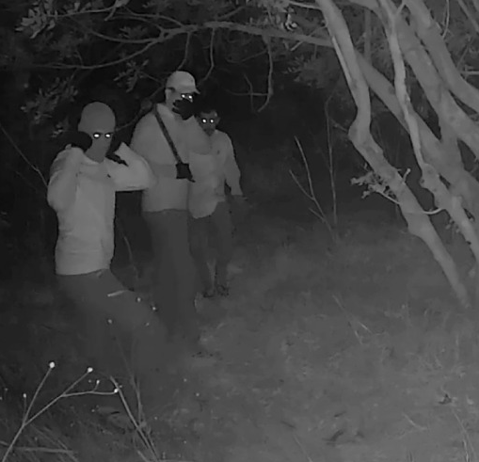




Operational Use Cases
Municipal Security & Smart Cities
Agriculture & Nature Reserves
Police & Emergency Services
Industrial & Manufacturing Sites
Military Bases & Facilities
Critical Infrastructure:
Border Security
12
Notes:
Slide 13: Operational Use Cases
Municipalities: Public safety, perimeter detection, community alerts
Defense & Police: Secure sensitive areas with fewer blind spots and respond faster to threats
Critical Infrastructure: Protect factories, utilities, and transport routes
Agriculture: Theft prevention, fire detection, and remote field monitoring
National Borders: Track movement across wide areas and coordinate fast response

Slide 13
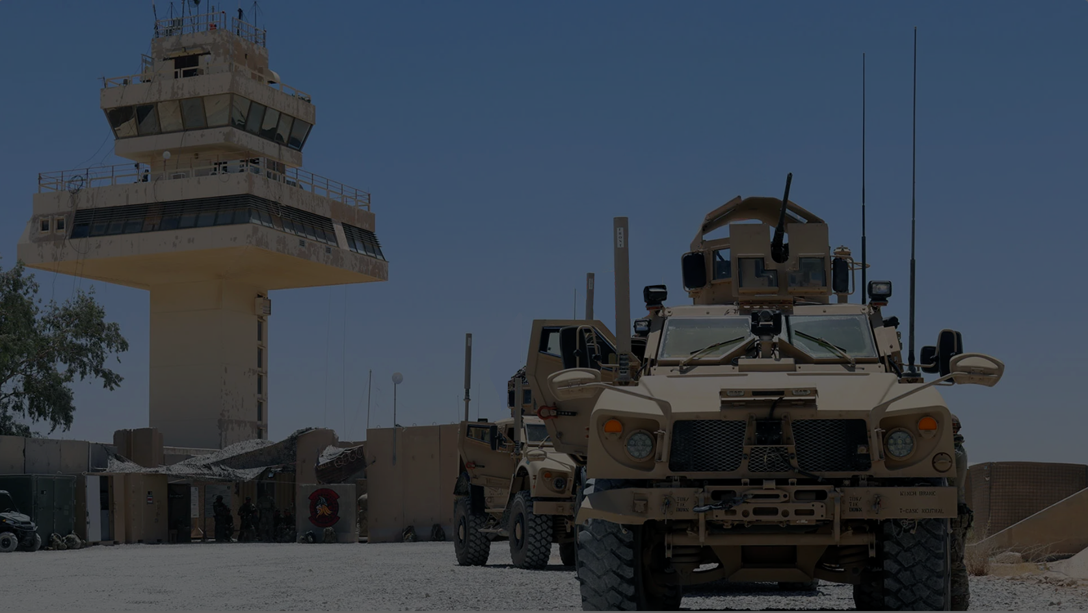
Military Bases & Facilities
Defense installations require fast reaction and zero blind spots. Zorronet delivers:
Ideal for bases, depots, airfields, and training areas
Autonomous monitoring of perimeter fences and sensitive areas
PTZ cameras track suspicious actors with smooth multi-camera handover
Automatic activation of lights, sensors, and access gates
AI-driven detection of unusual movement and enemy reconnaissance activity
Military-grade autonomy built for mission-critical environments.
13
Notes:
Slide 13: Operational Use Cases
Municipalities: Public safety, perimeter detection, community alerts
Defense & Police: Secure sensitive areas with fewer blind spots and respond faster to threats
Critical Infrastructure: Protect factories, utilities, and transport routes
Agriculture: Theft prevention, fire detection, and remote field monitoring
National Borders: Track movement across wide areas and coordinate fast response

Slide 14

Border Security
Long distances and complex terrain demand surveillance that never sleeps:
Ideal for both rural and high traffic border areas
Supports multi-agency and international border coordination
Track subjects over large distances using camera fusion
Prioritize threats and filter out environmental noise
Detect cross-border movement in remote or hard-to-monitor areas
Continuous autonomous watch over the nation’s most sensitive lines.
13
Notes:
Slide 13: Operational Use Cases
Municipalities: Public safety, perimeter detection, community alerts
Defense & Police: Secure sensitive areas with fewer blind spots and respond faster to threats
Critical Infrastructure: Protect factories, utilities, and transport routes
Agriculture: Theft prevention, fire detection, and remote field monitoring
National Borders: Track movement across wide areas and coordinate fast response

Slide 15
Police & Emergency Services
Zorronet enhances first responders with real-time intelligence from the field:
Live detection of incidents before calls arrive at dispatch
Automatic PTZ tracking of suspects and vehicles
Real-time video and mapped event data delivered straight to mobile units
Reduced operator overload enables faster emergency prioritization
Supports evidence collection with auto-generated video clips
Police and emergency teams gain instant clarity when every second matters.
13
Notes:
Slide 13: Operational Use Cases
Municipalities: Public safety, perimeter detection, community alerts
Defense & Police: Secure sensitive areas with fewer blind spots and respond faster to threats
Critical Infrastructure: Protect factories, utilities, and transport routes
Agriculture: Theft prevention, fire detection, and remote field monitoring
National Borders: Track movement across wide areas and coordinate fast response

Slide 16
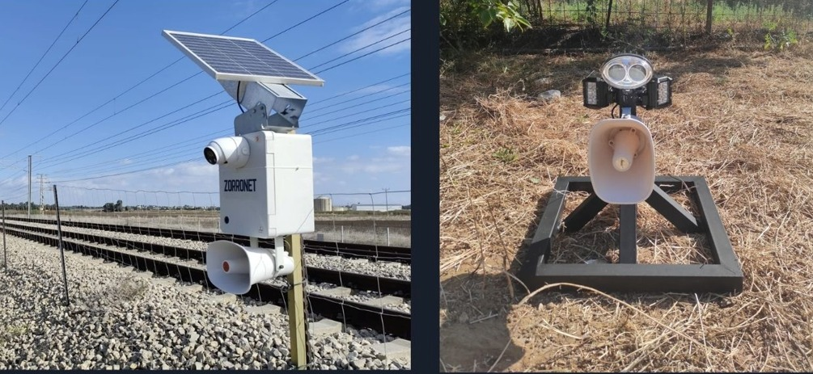
Critical Infrastructure Protection
Zorronet protects the assets society depends on:
Power plants, ports, airports, and more
Detect intrusions, suspicious behavior, and perimeter breaches
Autonomous routines secure restricted zones without human error
Full documentation for regulatory and compliance needs
Infrastructure stays protected with defense-grade precision.
13
Notes:
Slide 13: Operational Use Cases
Municipalities: Public safety, perimeter detection, community alerts
Defense & Police: Secure sensitive areas with fewer blind spots and respond faster to threats
Critical Infrastructure: Protect factories, utilities, and transport routes
Agriculture: Theft prevention, fire detection, and remote field monitoring
National Borders: Track movement across wide areas and coordinate fast response

Slide 17
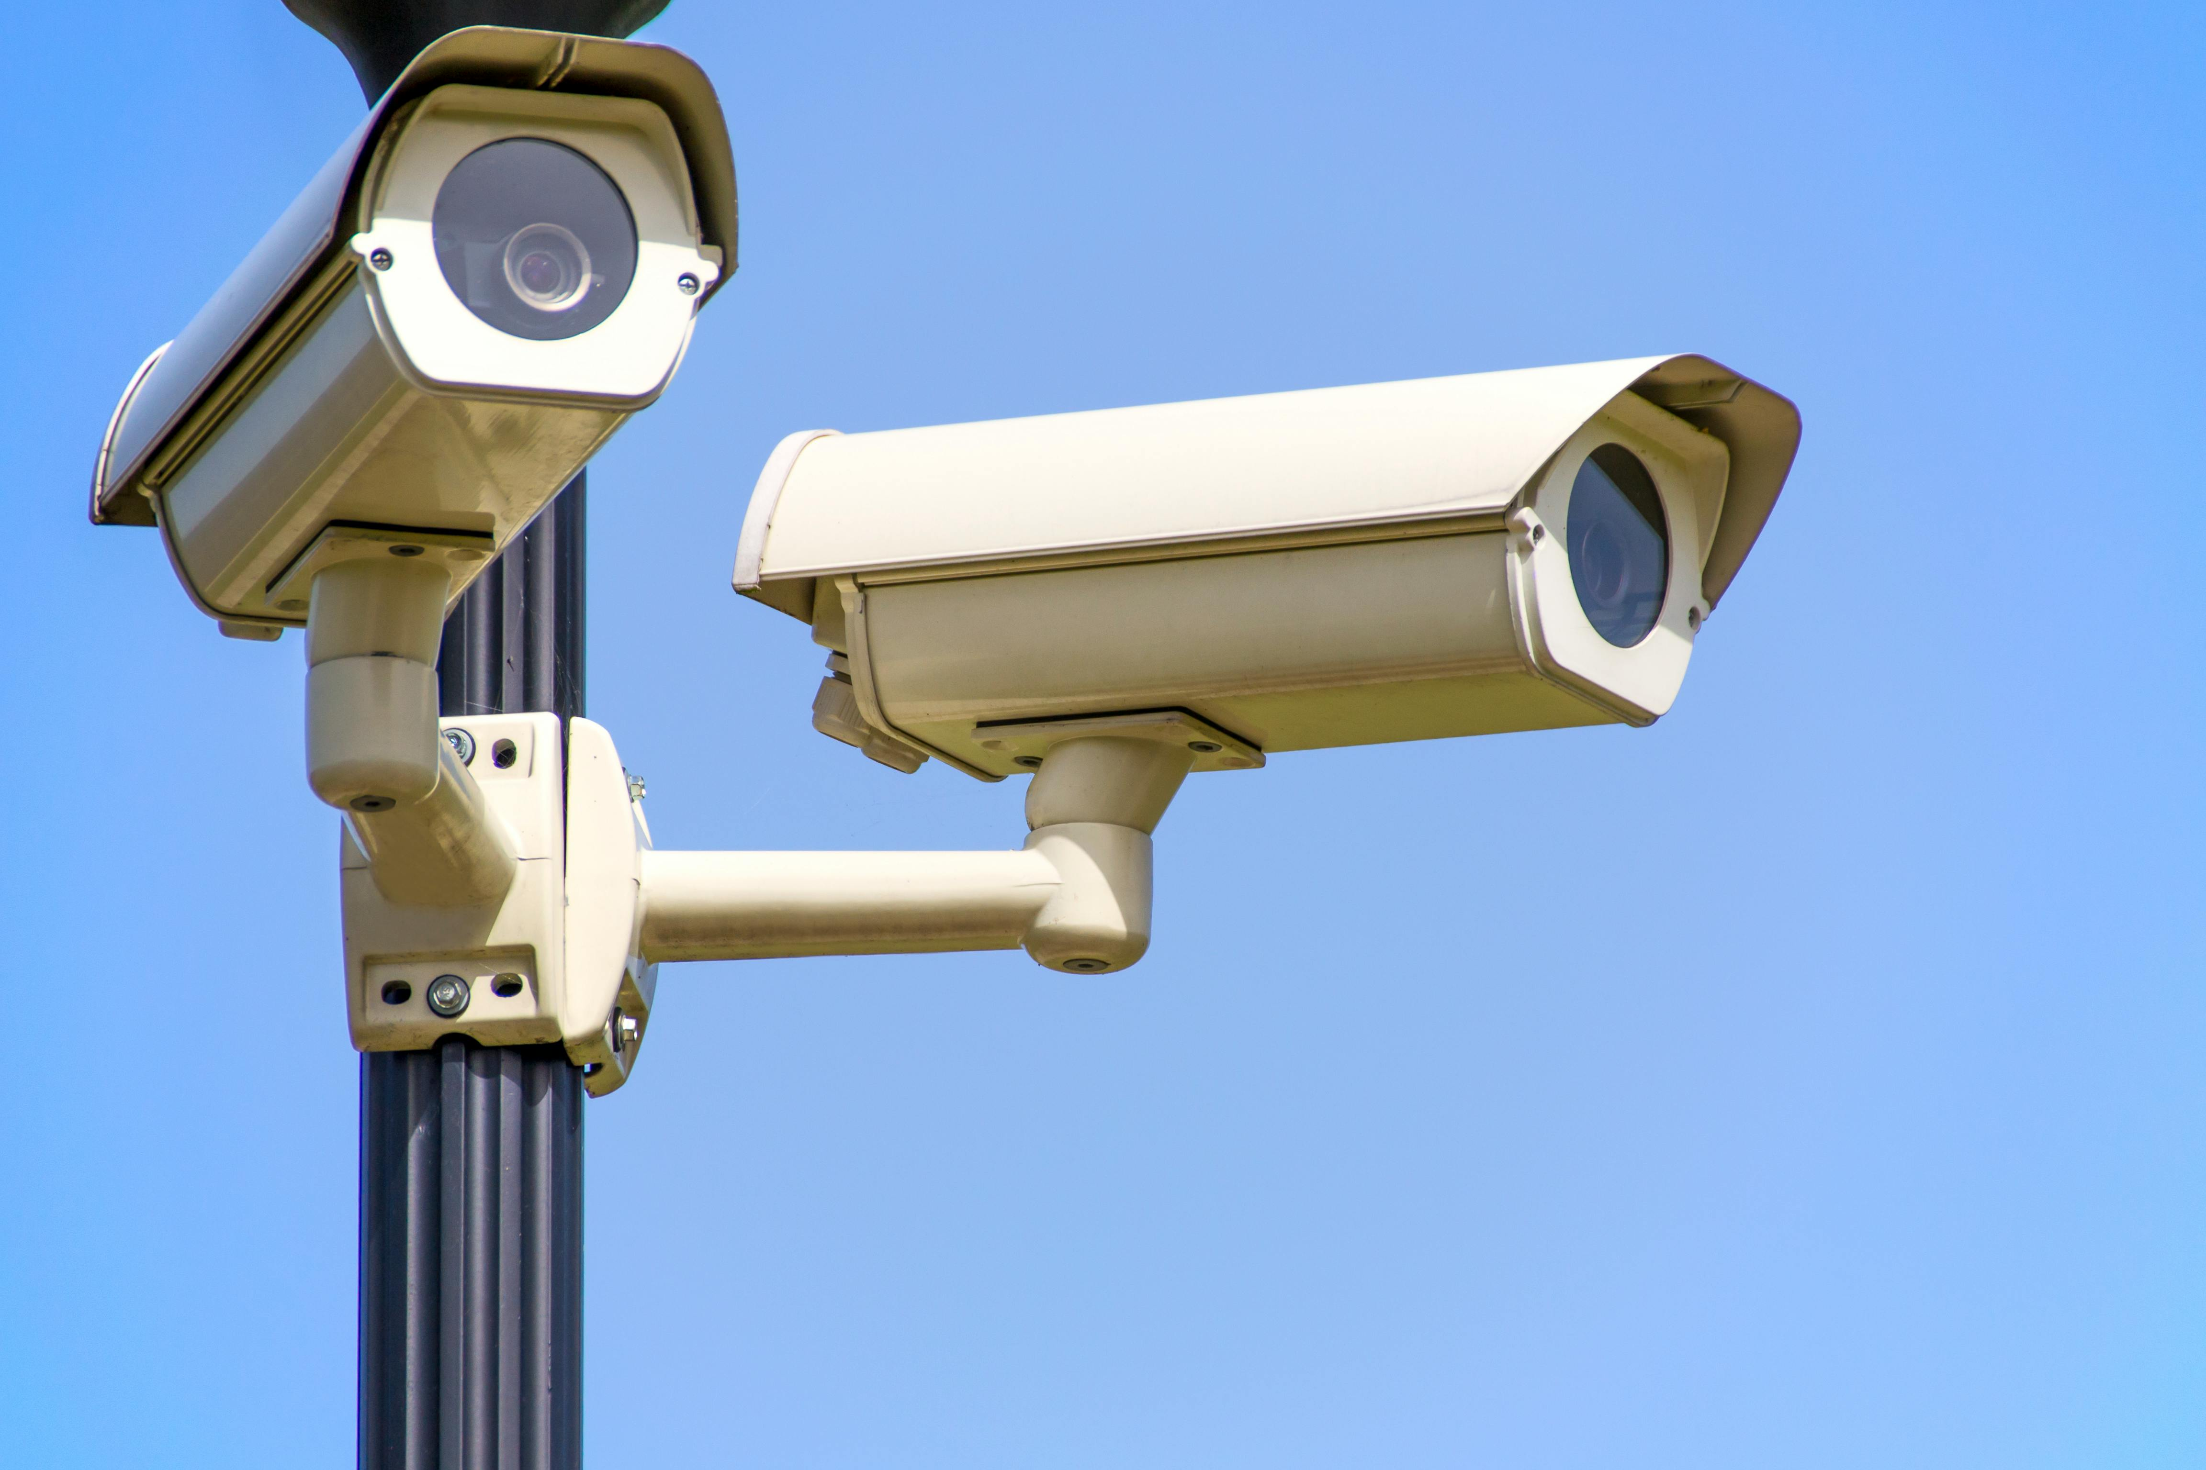
Municipal Security & Smart Cities
Zorronet provides municipalities with real-time, autonomous oversight of public spaces:
Improve safety around schools, playgrounds, nightlife areas, and public buildings
Enable city operations to react faster with a unified, autonomous security OS
Detect suspicious movement in parks, streets, and community areas
Track individuals across multiple camera zones
Reduce false alarms and unnecessary patrol dispatches
A smarter city is a safer city, without adding manpower.
13
Notes:
Slide 13: Operational Use Cases
Municipalities: Public safety, perimeter detection, community alerts
Defense & Police: Secure sensitive areas with fewer blind spots and respond faster to threats
Critical Infrastructure: Protect factories, utilities, and transport routes
Agriculture: Theft prevention, fire detection, and remote field monitoring
National Borders: Track movement across wide areas and coordinate fast response

Slide 18

Industrial & Manufacturing Sites
High-value equipment and inventory require constant vigilance:
Perfect for factories, warehouses, and distribution centers
Identify unauthorized people or vehicles in restricted zones
Detect nighttime intrusions and theft attempts
Reduce false alarms in busy operational environments
Coordinate alerts with gates, sensors, and security teams
Zorronet protects the assets that keep businesses running.
13
Notes:
Slide 13: Operational Use Cases
Municipalities: Public safety, perimeter detection, community alerts
Defense & Police: Secure sensitive areas with fewer blind spots and respond faster to threats
Critical Infrastructure: Protect factories, utilities, and transport routes
Agriculture: Theft prevention, fire detection, and remote field monitoring
National Borders: Track movement across wide areas and coordinate fast response

Slide 19
Agriculture & Nature Reserves
Large, remote areas become secure and visible:
Detect intruders, poachers, and agricultural theft
Track movement in fields, forests, and national parks
Filter out animals and environmental noise
Ideal for farms, conservation zones, and open landscapes
Zorronet brings autonomous protection to the wildest, hardest to reach locations.
13
Notes:
Slide 13: Operational Use Cases
Municipalities: Public safety, perimeter detection, community alerts
Defense & Police: Secure sensitive areas with fewer blind spots and respond faster to threats
Critical Infrastructure: Protect factories, utilities, and transport routes
Agriculture: Theft prevention, fire detection, and remote field monitoring
National Borders: Track movement across wide areas and coordinate fast response

Slide 20

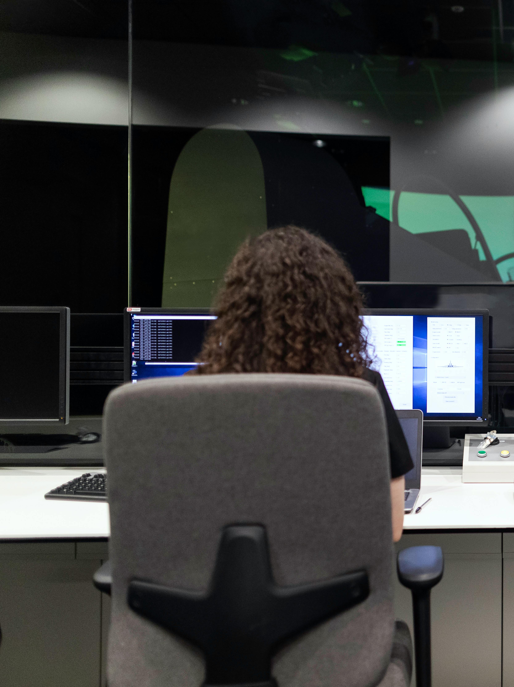






The Zorronet Advantage
Why customers switch to Zorronet:
Full autonomy, fewer false alarms, faster response
Proven defense-grade capabilities
One OS for all devices
Plug-and-play deployment
Actionable intelligence
Scalable from one site to national networks
Security becomes proactive, not reactive. Predictive, not passive. Autonomous, not manual.
14
Notes:
Slide 15: Why Zorronet
No hardware replacement - tech works with what you already have
Ultra-fast deployment
Multi-device coordination in real time
Closed, encrypted network
SaaS model ready for enterprise scale, from single sites to entire borders
Proven with national agencies, defense units, and major organizations

Slide 21

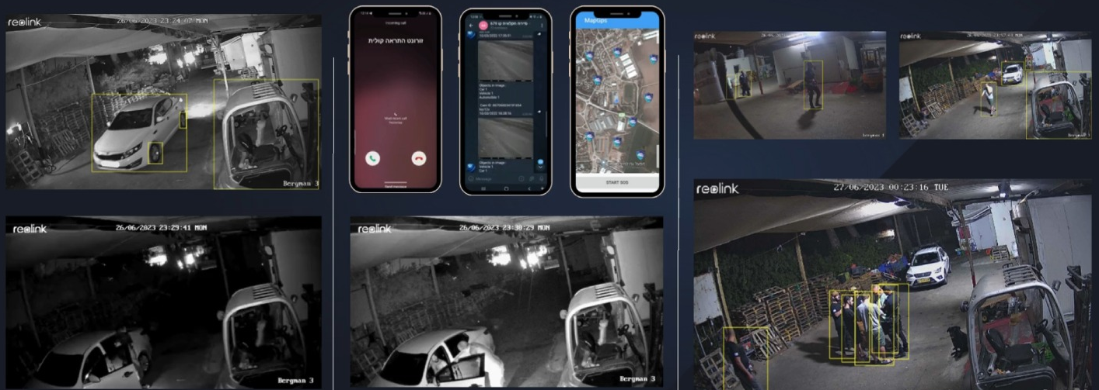
The Autonomous Future of Security
Threats evolve. Human monitoring doesn’t scale. But autonomous intelligence does.
Zorronet is building the next generation of autonomous security. A world where cameras think, systems react, and sites protect themselves.
15
Notes:
Slide 16 The Autonomous Future of Security
From manual monitoring to autonomous detection
From siloed systems to unified multi-device orchestration
From reactive response to proactive prevention
Zorronet delivers the next generation of AI-powered security operations

Slide 22


Welcome to autonomous security.
Welcome to Zorronet.
Contact: Idan Maayan
Emil: Idan@zorro-net.com
Website: www.zorro-net.com
Notes:
Slide 13:
Closing
Thank You
Contact:
CEO Dikla Yadid
Phone Number
Email

Slide 23


Use Case: Perimeter Security
An intruder approaches a restricted zone at night
Zorronet’s AI instantly detects movement and identifies the threat as a human carrying a weapon
Nearby PTZ cameras lock on, track the target, and hand off coverage across the perimeter
Patrol teams receive live video clips, a map location, and recommended actions
Gates and barriers respond automatically to secure access points
Commanders gain real-time awareness without needing to monitor feeds manually
13
Notes:
Slide 14: Use Case: Perimeter Security
An intruder approaches a restricted zone at night
Zorronet’s AI instantly detects movement and identifies the threat as a human carrying a weapon
Nearby PTZ cameras lock on, track the target, and hand off coverage across the perimeter
Patrol teams receive live video clips, a map location, and recommended actions
Gates and barriers respond automatically to secure access points
Commanders gain real-time awareness without needing to monitor feeds manually

