Slide 1

Procurement AI Agents

Slide 2
Minet Technologies
A company of innovative solutions in the world of procurement and supply chains.
Provides a precise solution for organizations that want to make complex processes useful and efficient.
Procurement outsourcing
Procurement Technologies
Projects, consulting, training
Notes:
Outsourcing procurement, super supplier with large companies
Consulting and training projects in the field of AI and data, doing taxonomy in a large company
Spoiler Discovery. A variety of solutions. Today we will see my metaphor.

Slide 3
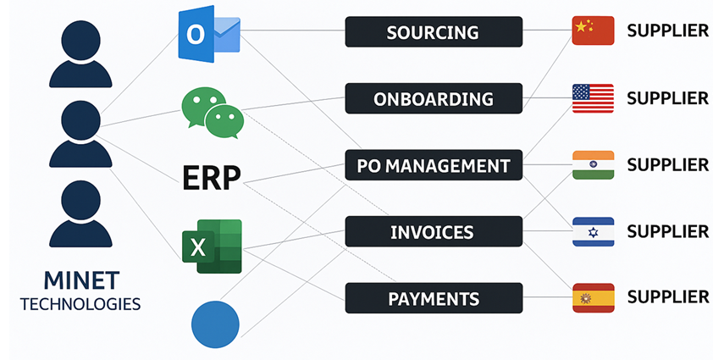
Today's Manual World of Procurement Technologies
The procurement processes rely on old technologies that are not adapted to today's business world
Your Team

Slide 4
What is AI Agent?
AI Agent is an autonomous software that uses artificial intelligence to perform tasks, make decisions, and adapt to new environments – with human intervention.
Analyzes large amounts of structured and unstructured information, generates meaningful insights, and acts in accordance with predefined goals.
Unlike traditional automation tools, AI agents are able to learn and improve over time – making them extremely flexible and efficient in changing environments.
Notes:
AI Agent is not just another automation tool.
It's a smart digital worker who works alone – analyzing information, making decisions, and learning all the time.
It reads contracts, monitors irregularities, writes emails, sends requests, updates systems.
Without being asked.
He doesn't wait for an order – he acts on his own initiative, according to predetermined rules.
And at sensitive points – the person in the picture. Always.
The agent formulates, you approve. Full control. Zero unnecessary fuss.
AI Agent is an AI-based software that performs tasks, makes decisions, and improves independently over time

Slide 5
AI Agent Basic Principles of Operation
Converting unstructured information – emails, PDFs, scanned documents – to structured information – data in ERP, other systems, Excel spreadsheets.
Analysis of the information collected.
Independent work with suppliers and other entities in accordance with the rules you will define.
The vendors speak natural language and love it.

Slide 6






What are the advantages?
Doing more and better with fewer resources
Save valuable time on routine and repetitive tasks
Reduce expenses and improve cash flow
Reduce risk and improve regulatory compliance
A system that learns your firm – and follows your rules faithfully
Dealing with Peaks
Proactive and automated communication – without missing anything along the way
Notes:
The benefits
of our AI agentare not meant to replace – but to strengthen.
It gives employees more time to engage in strategy, analysis, and decision-making – rather than searching for a file or copying numbers from an email to the system. You can do a lot more from those resources.
The agent knows how to deal with picks
, raising money for six months can be complicated. On the other hand, with an AI agent, it can be easier, which is important for organizations that are mainly project-oriented.
Efficiency - faster and better processes, fewer errors, dealing with peaks
Efficiency – better and more up-to-date data, better decisions, freeing up employee time for tasks with high added value
Compliance is higher.

Slide 7
What are the advantages?
The agent does not replace the person and is not
“stealing a work position".
It saves the technical, repetitive, error-prone parts –
and leaves people with what really matters:
Judgment, Creativity and Decision-making.
Better speed, accuracy and data quality
Our technology improves the efficiency and quality of your administrative processes.
✅ Faster processes
✅ fewer errors
✅ higher quality data
Notes:
The benefits
of our AI agentare not meant to replace – but to strengthen.
It gives employees more time to engage in strategy, analysis, and decision-making – rather than searching for a file or copying numbers from an email to the system. You can do a lot more from those resources.
The agent knows how to deal with picks
, raising money for six months can be complicated. On the other hand, with an AI agent, it can be easier, which is important for organizations that are mainly project-oriented.

Slide 8
What do we offer?
We offer AI agents that do significant automation of –
Sourcing
Operational Procurement
Sales
Procurement analytics

Slide 9
Operational Procurement Automation
Handling operational procurement processes, from issuing a demand through order confirmation and working with the entire supply chain.
Detect anomalies, track changes in purchase orders, and perform quick alerts.
Draft emails and perform automated actions, incorporating human-in-the-loop human approval where needed.
Control and approval of supplier invoices.
Interface with the organization's ERP systems.
Notes:
AI Agent knows how to take unstructured information – that is, various documents that are received from email, such as invoices from suppliers, receipts, Excel, scanned PDFs, and it actually knows how to take this information and make it structured – in an organized Excel, ERP system or another structured system. It can also sort the emails received into dedicated folders by subject – making it easier for humans to intervene later on.

Slide 10










Operational Procurement with AI Agent
customer
customer places an order
Supplier sends a response
AI imports Information into ERP
AI responds if needed according to the production plan
AI makes 3 Way Match
Invoice Approved for Payment
Notes:
Handling Inverses
3 Way Match Assuming that it is a physical commodity
, the company receives inverses from the suppliers, this is called APAccounts Payble, i.e. the amounts that the company must provide due to the purchase or services it provided for them.
There are 3 documents:
1. Invoices
2. PO purchase order
3. GR (Good Received) assuming that it is physical goods that have entered the warehouse, a document that acknowledges the shipment

Slide 11
Sourcing Automation
Traditional sourcing involves a long process:
collecting requirements, sending requests to suppliers, consolidating responses (RFQ), analyzing proposals, selection and ordering.
✔️ The agent identifies a need for a new order
✔️ Sends quotation requests to relevant suppliers (RFQs)
✔️ Coordinates the offers into one convenient form.
✔️ Identifies the most profitable offer according to defined criteria
✔️ Updates the ERP system and initiates the start of the ordering process
The agent doesn't wait to be told what to do –
he identifies the need, acts in accordance with the firms policies, and still keeps the human in the loop at critical moments.

Slide 12






Sourcing with AI Agent
Locating a new need for an order
Sending Vendor Requests (RFQ)
Uniform Concentration of Proposals
Identifying the most affordable offer
System starts an ordering process

Slide 13
Procurement analytics
Intelligent procurement analytics – insights that drive action.
Through analytics capabilities, the AI Agent allows the customer to understand whats really going on with their money:
✔️ In-depth analysis of expenses in all categories Identification
✔️ Identification of anomalies, duplicates, and discordancy with contract forms.
✔️ Practical recommendations: consolidation of suppliers, improvement of conditions, cost savings
✔️ Budget forecasts based on past data and contracts
✔️ Significantly shortens the time spent analyzing and issuing recommendations

Slide 14
Humans In The Loop
Combining Artificial Intelligence with Human Judgment
The AI Agent performs automated actions based on rules and continuous learning.
But in sensitive moments – the person remains part of the process:
  When there is a financial exceedance
  Changing payment terms
  A problem that requires human judgment
The agent formulates a response (e.g. an email to the supplier), and the human worker approves or edits before sending.
In this way, you maintain full control and reduce the load on repetitive work – without sacrificing human responsibility.

Slide 15
Our Uniqueness
Deep understanding and comprehensive coverage of procurement and supply chain processes.
High integration capabilities with ERP and other systems.
Customizing the agent to your process.
Development capabilities in some cases.
We try harder.

Slide 16
Thank you
Gal Eliav
Minet Technologies
054-9549156
Gal@minet.co.il

